Slide 1

TIRZEPATIDE: REAL LIFE EVIDENCE
Giovanna Muscogiuri
Università degli studi di Napoli "Federico II "

Slide 2
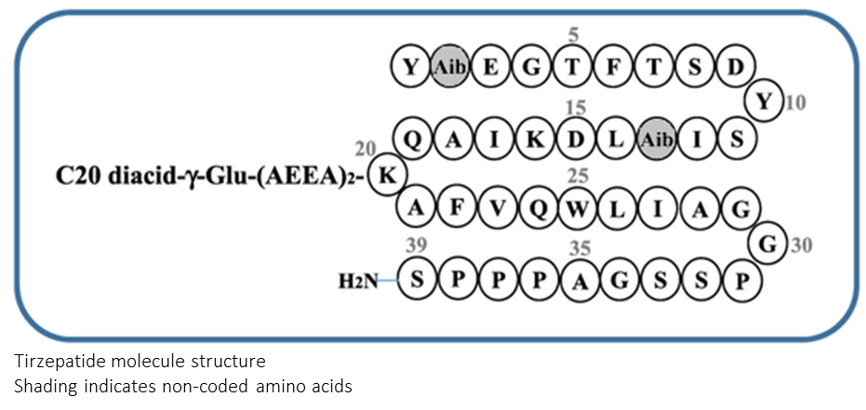
Tirzepatide: A Novel GIP and GLP-1 Receptor Agonist
Molecular Attributes
Tirzepatide is a multi-functional peptide engineered from the native GIP peptide sequence, modified to bind to both GIP and GLP-1 receptors
39 amino acid linear peptide and includes a C20 fatty diacid moiety
Conjugated to a C20 fatty diacid moiety via a hydrophilic linker connected to the lysine residue at position 20. (This allows the binding of the molecule to albumin and prolongation of its half-life)
Contains two non-coded amino acid residues at positions 2 and 13 (Aib, a-amino isobutyric acid)
the C-terminus is amidated (this removes the charge form the C-terminus, more closely mimics the native protein, and therefore may increase the biological activity of a peptide. It also tends to increase the stability and prolongs their shelf life)
The molecular weight is 4.8 kD (dula 63 kD, sema 4.11 kD)
GIP = glucose-dependent insulinotropic polypeptide; GLP-1R = glucagon-like peptide-1
1. Coskun T, et al. Mol Metab. 2018;18:3-14. 2. Urva S, et al. Diabetes. 2020;69(Suppl. 1):Abstract 971-P.

Slide 3
Tirzepatide Potency and Affinity for GIP and GLP-1 Receptors
In vitro, tirzepatide has a potency/affinity for the GIP receptor similar to native GIP
Potency/affinity for the GLP-1 receptor is slightly weaker compared with native GLP-1
GIP Receptor
GLP-1 Receptor
cAMP activation (%)
cAMP activation (%)
GIP
GLP-1
TZP
TZP
log [Treatment] M
log [Treatment] M
cAMP = cyclic adenosine monophosphate; TZP = tirzepatide.
Coskun T, et al. Mol Metab. 2018;18:3-14.
Company Confidential © 2021 Eli Lilly and Company
Notes:
Abbreviations
cAMP = cyclic adenosine monophosphate; GIP = glucose-dependent insulinotropic polypeptide; GLP-1 = glucagon-like peptide-1; T2D = type 2 diabetes; TZP = tirzepatide.
Speaker notes
Prior to administration to healthy volunteers and people with T2D in the phase 1/1b proof-of-concept study, tirzepatide was characterized in vitro
In signaling studies using recombinant cell lines expressing GIP receptor or GLP-1 receptor, tirzepatide potently stimulated cAMP accumulation, an indirect way to measure binding to either receptor
recombinant cell lines expressing GIP or GLP-1 receptors
References
Coskun T, Sloop KW, Loghin C, et al. LY3298176, a novel dual GIP and GLP-1 receptor agonist for the treatment of type 2 diabetes mellitus: from discovery to clinical proof of concept. Mol Metab. 2018;18:3-14. doi: 10.1016/j.molmet.2018.09.009. Epub October 3, 2018. PMID: 30473097; PMCID: PMC6308032.

Slide 4
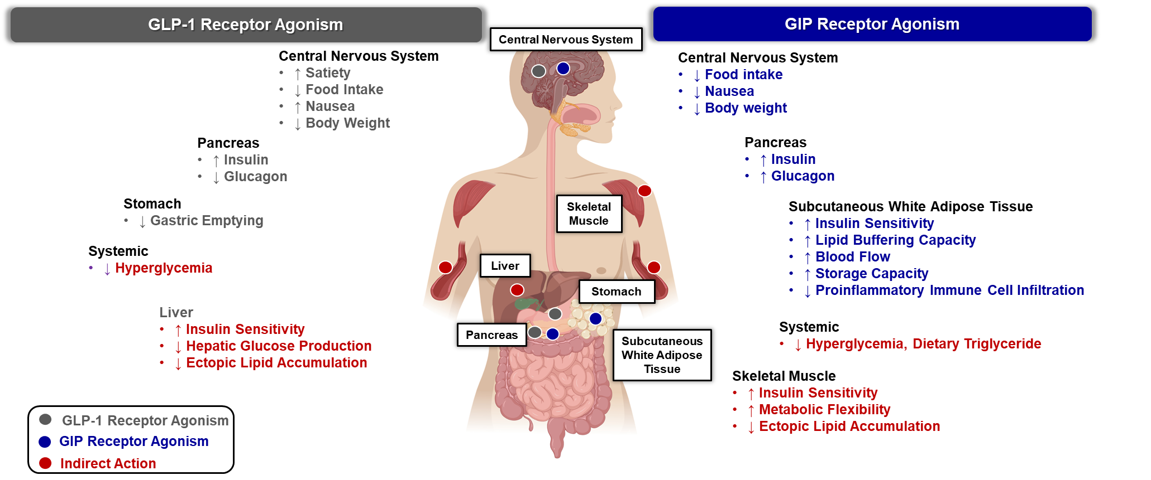
Can next generation incretin therapies combine GLP-1R and GIPR-mediated actions?
Adapted from: Samms RJ, et al. Trends Endocrinol Metab. 2020;31(6):410-421
Notes:
Despite the robust efficacy profile of the GLP-1 RA class, there are patients treated with these agents who would benefit from additional glycemic and/or body weight control.
The mechanism of action by which a dual GIP/GLP-1 receptor agonist improves glycemic and weight control in T2D has not been fully elucidated. The contribution of GLP-1 R agonism to these favorable PD effects is well established. As with selective GLP-1 RAs, these include enhancement of glucose-stimulated insulin secretion from the pancreatic beta-cell (incretin effect), reduction of glucagon secretion from the pancreatic alpha-cell, and reduced nutrient intake via central effects, promoting weight loss. The role of GIPR agonism is less clear and continues to be an area of active investigation.
GIP is a 42 amino acid peptide that is produced within and released from intestinal K cells that are located primarily in the proximal small bowel. Similar to GLP1, GIP is secreted in response to nutrient ingestion and enhances meal-stimulated insulin secretion in a glucose-dependent manner by activating its cognate GIP receptor (GIPR) in pancreatic beta cells (Baggio Molecular Metabolism 2020).
The Dual GIP/GLP-1 Hypothesis
Activating both the GIP and GLP-1 receptors is especially attractive in the treatment of T2DM because the combined mechanisms may enhance insulin secretion, decrease energy consumption, and both directly and indirectly improve insulin sensitivity. The approach is feasible because improved glycemia restores sensitivity to GIP, and peptide engineering enables the design of hybrid ligands that exhibit dual agonism. Strong effects of dual agonism are predicted for insulin secretion because both receptors are found in pancreatic β cells; however, the CNS shows both overlapping and differential receptor distributions in various metabolic centers, and adipocytes only express GIPR. Activation of GIPR in the brain andwhite adipose tissue (WAT) could be uniquely complementary to GLP-1R signaling. If GIP expands the tolerance window of GLP1 RAs, and GIP improves WAT function and lipid handling, dual incretin agonists may advance therapeutic outcomes (Samms 2020).
With respect to the incretin effect, at least partial restoration of beta-cell responsiveness to GIP has been demonstrated with the lowering of glucose concentrations into the normal or near-normal range. Given this, it has been postulated that improvement in glycemic control, initially with GLP-1-related activity, may restore beta-cell responsiveness to GIP by, in a sense, ‘priming’ the beta-cell for the additional favorable effects of GIPR agonism.
GIP Enhances the Lipid-Buffering Capacity of WAT
Additionally, it has been postulated that the effects of GIP on adipose tissue may play an important role in the pharmacodynamic effects of the dual GIP/GLP-1 RAs. The GIPR, unlike the GLP-1 R, is highly expressed in adipose tissue and plays an important physiologic role in acutely clearing dietary triglycerides and in overall adipocyte health. A recent review by Samms, et al. elegantly outlines the role GIP plays in promoting normal adipocyte lipid storage and release, and helping prevent the deleterious consequences of dysfunctional adipocytes (common in T2D), including ectopic fat accumulation (liver, skeletal muscle, pancreas) and impaired secretion of insulin-sensitizing adipokines such as adiponectin (Frias Expert Review of Endocrinology and Metabolism 2020; Samms 2020).
Indeed, GIPR agonism is hypothesized to enhance the ability of adipocytes to acutely clear dietary triglyceride (TAG), as well as improve the long-term storage of lipids through facilitating the healthy expansion of WAT. Expanding WAT to store calories reduces lipid ‘spillover’ and ectopic fat accumulation in tissues such as liver, skeletal muscle, heart, and pancreas (Samms 2020). In humans under experimental conditions simulating the postprandial period, GIP increases WAT blood flow, lowers FFAs, and stimulates glucose uptake and TAG storage in WAT. Importantly, GIP infusion can drive TAG storage in WAT and reduce circulating FFAs in T2DM patients, although there is evidence that the lipogenic effect of GIP on WAT blood flow and TAG deposition is attenuated in T2DM, an effect possibly linked to reduced GIPR expression in WAT. However, in follow-up experiments, the ability of GIP to increaseWAT perfusion and TAG storage was rescued by weight loss (Samms 2020). GIP promotes TAG storage following food intake by directly activating GIPR on adipocytes, indirectly through the lipogenic actions of insulin, or through the combination of the two. The GIPR is expressed in both visceral and subcutaneous WAT. GIP may also improve energy storage by facilitating WAT expansion (Samms 2020)
GIP Can Act in the CNS to Lower Food Intake and Reduce Body Weight
Several lines of evidence support a central mode of action for GIP. The GIPR is widely expressed within the CNS and is found in areas implicated in regulating energy balance. Although the data are limited, GIP appears to be capable of crossing the blood–brain barrier to access sites of action. For metabolic disease, experiments show that GIPR agonism can drive weight loss (Samms 2020).
More recent preclinical studies have demonstrated that the central genetic activation of GIPR + neurons in the hypothalamus may also reduce food intake and promote weight loss, findings consistent with the peripheral administration of long-acting degradation-resistant GIPR agonists in mice with diet-induced obesity (Baggio Molecular Metabolism 2020).
A key finding of this work is that, within the hypothalamus, GIPR is expressed by cells lacking GLP-1R but also in cells where GLP-1R is found (in mice and humans). Therefore, GIP/GLP-1 synergism may occur by activating each receptor on separate cells (classical signaling pathways), on the same cell (generating a unique signal), or the downstream integration of both. Other studies indicate that GIP and GLP-1 activate distinct neurons when inhibiting food intake. Notably, GIPR is expressed in non-neuronal cells of the mediobasal hypothalamus.. This raises the possibility that GIP may enhance GLP-1 function by increasing its access to anorexigenic neuronal populations within the mediobasal hypothalamus. Further, other studies show that central and peripheral administration of GIPR agonists lowers body weight by reducing caloric intake (Samms 2020).
With respect to glucagon, it is well established that the GLP-1 receptor agonism reduces glucagon concentrations. Short-term studies assessing acute GIP infusions in patients with T2D have demonstrated increased glucagon concentrations, including, as mentioned above, patients with well-controlled diabetes on chronic GLP-1 RA therapy. Clinical studies assessing short term co-infusion of GLP-1 and GIP RAs or administration of an unimolecular dual GLP-1/GIP RAs in patients with T2D have generally demonstrated a neutral effect on glucagon concentrations, with the glucagonotropic effect of GIPR agonism being ‘nullified’ by the glucagonostatic effect of the GLP-1 RA. Interestingly, fasting glucagon concentrations were reduced to a greater extent after 26 weeks of tirzepatide therapy compared with the selective GLP-1 RA dulaglutide in the 26-week Phase 2 clinical trial (Frias Review 2020).
A factor affecting the tolerability of GLP-1RA treatment is the occurrence of drug-related nausea. Interestingly, GIPR agonism attenuates the aversive and emetic responses characteristic of the gut peptide PYY and the oncology drug cisplatin, respectively. This suggests a novel hypothesis where GIP may enhance GLP1R-mediated weight loss by increasing tolerance, thereby expanding the therapeutic index. Together, current evidence suggests that GIP has the potential to drive weight loss by directly targeting its receptor in the CNS to inhibit caloric intake, by enhancing the anorectic action of GLP-1, or by reducing drug-induced nausea to expand GLP-1RA efficacy, or combinations thereof (Samms 2020).
The primary physiological role of WAT is to function as a daily buffer of circulating lipids [22], releasing free fatty acids (FFAs) in the fasted state and storing dietary lipid in the fed state (Box 1). In T2DM, the lipid-buffering capacity of WAT is dysregulated because storage capacity is exceeded and is accompanied by reduced insulin-mediated suppression of FFA release, lowered adipose tissue perfusion (blood flow), and impaired recruitment of lipoprotein lipase (LPL)

Slide 5
SURMOUNT: Tirzepatide in People With Obesity
Phase 3 Global Clinical Trials Overview
Phase 3 SURMOUNT Program
SURMOUNT-1: Weight Management¹
SURMOUNT-2: Weight Management in T2D²
SURMOUNT-3: Weight Management After Intensive Lifestyle Intervention³
SURMOUNT-4: Maintenance of Weight Loss⁴
SURMOUNT-5: Weight Management in Participants With Weight-Related Comorbidities⁵
Primary completion date:
April 2022
April 2023
May 2023
May 2023
November 2024
(Ongoing)
Number of
study participants:
2539
938
806
783
700
Treatment duration:
72 weeks
72 weeks
72 weeks
88 weeks
72 weeks
(36 weeks open-label treatment followed by 52 weeks double-blind treatment)
Prediabetes Extension to 176 Weeks
Intervention/treatment:
TZP 5, 10, 15 mg QW
TZP 10, 15 mg QW
TZP MTD (10 or 15 mg) QW
TZP MTD (10 or 15 mg) QW
TZP QW
PBO QW
PBO QW
PBO QW
PBO QW
SEMA QW
Abbreviations and references are listed in speaker notes section below.
Notes:
Abbreviations:
MTD=Maximum Tolerated Dose; PBO=Placebo; QW=Once-Weekly; SEMA=Semaglutide; TZP=Tirzepatide; T2D=Type 2 Diabetes.
References:
Jastreboff AM, Aronne LJ, Ahmad NN, et al. Tirzepatide once weekly for the treatment of obesity. N Engl J Med. 2022;387(3):205-216.
Garvey WT, Frias JP, Jastreboff AM, et al. Tirzepatide once weekly for the treatment of obesity in people with type 2 diabetes (SURMOUNT-2): a double-blind, randomised, multicentre, placebo-controlled, phase 3 trial. Lancet. 2023;402(10402):613-626.
Wadden TA, Chao AM, Machineni S, et al. Tirzepatide after intensive lifestyle intervention in adults with overweight or obesity: the SURMOUNT-3 phase 3 trial. Nat Med. 2023;29:2909-2918.
Aronne LJ, Sattar N, Horn DB, et al. Continued treatment with tirzepatide for maintenance of weight reduction in adults with obesity: The SURMOUNT-4 Randomized Clinical Trial. JAMA. 2024;331(1)38-48.
ClinicalTrials.gov. A study of tirzepatide (LY3298176) in participants with obesity or overweight with weight related comorbidities (SURMOUNT-5). https://classic.clinicaltrials.gov/ct2/show/NCT05822830 (Accessed November 12, 2023).
QC completed by L-MACH, LCCI, July 24, 2024. Separate individuals at L-MACH created the slide (June 24, 2024) and performed data review (June 24, 2024).

Slide 6
SURMOUNT: Tirzepatide in People With Obesity
Phase 3 Global Clinical Trials Overview
Phase 3 SURMOUNT Program
SURMOUNT-MAINTAIN:
Maintenance of
Weight Loss¹
SURMOUNT-ADOLESCENTS:
Weight Management in Adolescents²
SURMOUNT-J: Weight Management With Diet and Physical Activity³
SURMOUNT-CN: Weight Management⁴
Primary completion date:
May 2026
(Ongoing)
October 2026
(Ongoing)
June 2023
(Ongoing)
December 2022
Number of
study participants:
400
150
261
210
Treatment duration:
112 weeks
72 weeks
72 weeks
52 weeks
Intervention/treatment:
TZP 5 mg QW
TZP QW
TZP Regimen A, B QW
TZP Dose 1, Dose 2 QW
TZP MTD QW
PBO QW
PBO QW
PBO QW
PBO QW
Abbreviations and references are listed in speaker notes section below.
Notes:
Abbreviations:
MTD=Maximum Tolerated Dose; PBO=Placebo; QW=Once-Weekly; TZP=Tirzepatide; T2D=Type 2 Diabetes.
References:
ClinicalTrials.gov. A study of LY3298176 (Tirzepatide) for the maintenance of body weight reduction in participants who have obesity or overweight with weight-related comorbidities. https://classic.clinicaltrials.gov/ct2/show/NCT06047548 (Accessed November 12, 2023).
ClinicalTrials.gov. A study of tirzepatide (LY3298176) once weekly in adolescent participants who have obesity, or are overweight with weight-related comorbidities. https://classic.clinicaltrials.gov/ct2/show/NCT06075667 (Accessed November 12, 2023).
ClinicalTrials.gov. A study of tirzepatide (LY3298176) in participants with obesity disease (SURMOUNT-J). https://www.clinicaltrials.gov/ct2/show/NCT04844918 (Accessed November 12, 2023).
ClinicalTrials.gov. A study of tirzepatide (LY3298176) in Chinese participants without type 2 diabetes who have obesity or overweight (SURMOUNT-CN) (SURMOUNT-CN). https://www.clinicaltrials.gov/ct2/show/NCT05024032 (Accessed November 12, 2023).
QC completed by L-MACH, LCCI, July 24, 2024. Separate individuals at L-MACH created the slide (June 24, 2024) and performed data review (June 24, 2024).

Slide 7
SURMOUNT: Tirzepatide in People With Obesity
Phase 3 Global Clinical Trials Overview
Phase 3 SURMOUNT Program
SURMOUNT-1: Weight Management¹
SURMOUNT-2: Weight Management in T2D²
SURMOUNT-3: Weight Management After Intensive Lifestyle Intervention³
SURMOUNT-4: Maintenance of Weight Loss⁴
SURMOUNT-5: Weight Management in Participants With Weight-Related Comorbidities⁵
Primary completion date:
April 2022
April 2023
May 2023
May 2023
November 2024
(Ongoing)
Number of
study participants:
2539
938
806
783
700
Treatment duration:
72 weeks
72 weeks
72 weeks
88 weeks
72 weeks
(36 weeks open-label treatment followed by 52 weeks double-blind treatment)
Prediabetes Extension to 176 Weeks
Intervention/treatment:
TZP 5, 10, 15 mg QW
TZP 10, 15 mg QW
TZP MTD (10 or 15 mg) QW
TZP MTD (10 or 15 mg) QW
TZP QW
PBO QW
PBO QW
PBO QW
PBO QW
SEMA QW
Abbreviations and references are listed in speaker notes section below.
Notes:
Abbreviations:
MTD=Maximum Tolerated Dose; PBO=Placebo; QW=Once-Weekly; SEMA=Semaglutide; TZP=Tirzepatide; T2D=Type 2 Diabetes.
References:
Jastreboff AM, Aronne LJ, Ahmad NN, et al. Tirzepatide once weekly for the treatment of obesity. N Engl J Med. 2022;387(3):205-216.
Garvey WT, Frias JP, Jastreboff AM, et al. Tirzepatide once weekly for the treatment of obesity in people with type 2 diabetes (SURMOUNT-2): a double-blind, randomised, multicentre, placebo-controlled, phase 3 trial. Lancet. 2023;402(10402):613-626.
Wadden TA, Chao AM, Machineni S, et al. Tirzepatide after intensive lifestyle intervention in adults with overweight or obesity: the SURMOUNT-3 phase 3 trial. Nat Med. 2023;29:2909-2918.
Aronne LJ, Sattar N, Horn DB, et al. Continued treatment with tirzepatide for maintenance of weight reduction in adults with obesity: The SURMOUNT-4 Randomized Clinical Trial. JAMA. 2024;331(1)38-48.
ClinicalTrials.gov. A study of tirzepatide (LY3298176) in participants with obesity or overweight with weight related comorbidities (SURMOUNT-5). https://classic.clinicaltrials.gov/ct2/show/NCT05822830 (Accessed November 12, 2023).
QC completed by L-MACH, LCCI, July 24, 2024. Separate individuals at L-MACH created the slide (June 24, 2024) and performed data review (June 24, 2024).

Slide 8

Tirzepatide in Obesity Management: Real-World Multicenter Study by the Italian Society of Obesity Campania Region
The aim was to evaluate the short-term effects of tirzepatide 2.5 mg and 5.0 mg on weight changes and modifications in metabolic parameters in adults with obesity, in a real-world outpatient setting, and to assess its tolerability profile at these initial doses

Slide 9
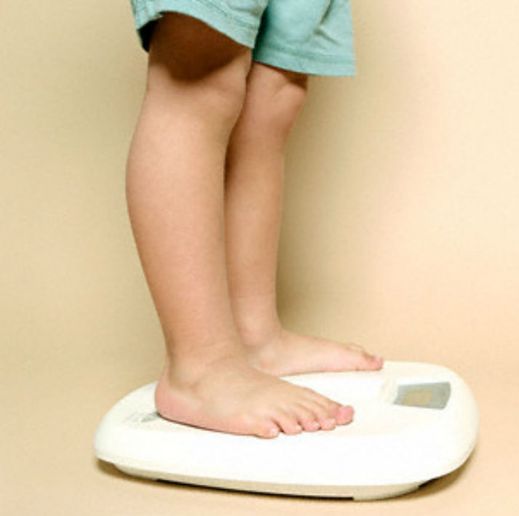
Tirzepatide in Obesity Management: Real-World Multicenter Study by the Italian Society of Obesity Campania Region
Methods: Retrospective, multicenter study included adults with obesity and without T2DM who were prescribed tirzepatide for weight management. Data were collected retrospectively from multiple outpatient clinics across Italy between January and June 2025.

Slide 10

Tirzepatide in Obesity Management: Real-World Multicenter Study by the Italian Society of Obesity Campania Region
BMI
WC
Prediabetes
Lipid profile
AST, ALT
Fasting plasma glucose, fasting
insulin, HOMA – IR
Side effects

Slide 11


Italian Society of Obesity – Campania Region Study Group
Luigi Barrea*, Ludovica Verde*, Martina Galasso*, Renato Patrone, Lucia Digitale, Alessandro Limardi, Marcello Orio, Ragozzino Giovanni, Luigi Digitale, Vittorio Salvatore, Antonella Savoia, Silvia Savastano, Annamaria Colao, Giovanna Muscogiuri

Slide 12
Changes in anthropometric and laboratory parameters from baseline to Tirzepatide 2.5 mg and 5.0 mg
Characteristic | Baseline | Tirzepatide 2.5 mg | p-value | Tirzepatide 5.0 mg | p-value | p-value*
Body weight – kg (N=70) | 105.9 ± 23.6 | 100.9 ± 22.6 | <0.001 | 92.6 ± 22.2 | <0.001 | <0.001
Mean BMI – kg/m² (N=70) | 37.5 ± 6.8 | 35.7 ± 6.5 | <0.001 | 32.7 ± 6.4 | <0.001 | <0.001
BMI category – no. (%)
< 25.0 kg/m² (N=70) | 0 | 0 | - | 6 (8.6) | χ²=4.35, p=0.037 | χ²=4.35, p=0.037
≥ 25.0 to < 30.0 kg/m² (N=70) | 8 (11.4) | 13 (18.6) | χ²=0.90, p=0.344 | 17 (24.3) | χ²=3.12, p=0.075 | χ²=0.38, p=0.537
≥ 30.0 to < 35.0 kg/m² (N=70) | 21 (30.0) | 22 (31.4) | χ²=0.00, p=1.00 | 26 (37.1) | χ²=0.51, p=0.474 | χ²=0.53, p=0.045
≥ 35.0 to < 40.0 kg/m² (N=70) | 20 (28.6) | 18 (25.7) | χ²=0.04, p=0.849 | 12 (17.1) | χ²=1.99, p=0.159 | χ²=1.06, p=0.303
≥ 40.0 kg/m² (N=70) | 21 (30.0) | 17 (24.3) | χ²=0.33, p=0.569 | 9 (12.9) | χ²=5.13, p=0.024 | χ²=2.31, p=0.128
WC – cm (N=59) | 117.8 ± 16.1 | 113.1 ± 16.7 | <0.001 | 104.8 ± 15.7 | <0.001 | <0.001
Total cholesterol – mg/dl (N=34) | 201.3 ± 40.7 | 189.2 ± 33.2 | 0.001 | 179.1 ± 28.3 | <0.001 | 0.006
LDL cholesterol – mg/dl (N=32) | 129.8 ± 31.0 | 115.3 ± 27.5 | <0.001 | 102.6 ± 21.7 | <0.001 | 0.001
HDL cholesterol – mg/dl (N=33) | 47.4 ± 13.6 | 50.3 ± 13.4 | 0.001 | 52.2 ± 11.7 | <0.001 | 0.032
Triglycerides – mg/dl (N=34) | 153.4 ± 51.4 | 139.8 ± 40.9 | 0.002 | 124.4 ± 34.8 | <0.001 | <0.001
Prediabetes, yes – no. (%) (N=35) | 17 (48.6) | 11 (31.4) | <0.001 | 4 (11.4) | 0.029 | 0.002
Fasting plasma glucose – mg/dl (N=36) | 103.6 ± 14.1 | 95.6 ± 14.4 | <0.001 | 90.2 ± 12.1 | <0.001 | <0.001
Fasting insulin – mIU/ml (N=34) | 27.8 ± 11.8 | 20.8 ± 8.4 | <0.001 | 15.7 ± 6.8 | <0.001 | <0.001
HOMA-IR (N=33) | 7.3 ± 3.2 | 5.1 ± 2.1 | <0.001 | 3.6 ± 1.6 | <0.001 | <0.001
c
c
c
c
p-values from paired t-test or chi-square test as appropriate
* comparing Tirzepatide 2.5 mg and Tirzepatide 5.0 mg

Slide 13

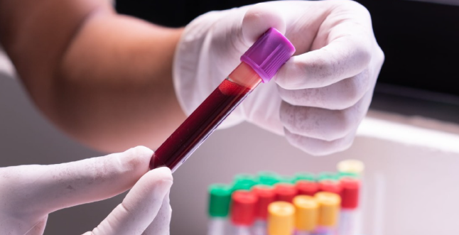
Percentage change in body weight after treatment with tirzepatide 2.5 mg and 5 mg
% change in body weight | Tirzepatide 2.5 mg (n=70) | Tirzepatide 5.0 mg (n=70) | p-value
Mean (%) | -4.7 ± 2.6 | -12.7 ± 5.4 | <0.001
< 5 no. (%) | 43 (61.4) | 2 (2.9) | χ²=52.40, p<0.001
> 5 no. (%) | 27 (28.6) | 68 (97.1)
> 10 no. (%) | 3 (4.3) | 48 (68.6) | χ²=59.71, p<0.001
> 15 no. (%) | 1 (1.4) | 19 (27.2) | χ²=16.86, p<0.001
p-values from paired t-test or chi-square test as appropriate between Tirzepatide 2.5 mg and Tirzepatide 5.0 mg
Changes in laboratory parameters from baseline to Tirzepatide 2.5 mg and 5.0 mg
Characteristic | Baseline | Tirzepatide 2.5 mg | p-value | Tirzepatide 5.0 mg | p-value | p-value*
Amylase – U/L (N=44) | 52.0 ± 15.8 | 55.0 ± 16.7 | 0.112 | 56.5 ± 18.7 | 0.016 | 0.717
Lipase – U/L (N=43) | 36.3 ± 13.9 | 38.5 ± 17.5 | 0.081 | 40.3 ± 17.4 | 0.064 | 0.382
AST– U/L (N=48) | 34.6 ± 11.5 | 31.1 ± 10.1 | 0.012 | 28.9 ± 9.5 | <0.001 | 0.006
ALT – U/L (N=44) | 41.6 ± 15.7 | 36.0 ± 12.5 | 0.055 | 32.1 ± 10.3 | <0.001 | 0.007
Estimated GFR – ml/min/1.73 m² (N=27) | 83.2 ± 13.2 | 84.6 ± 12.0 | 0.025 | 85.6 ± 11.6 | 0.005 | 0.064
p-values from paired t-test
* comparing Tirzepatide 2.5 mg and Tirzepatide 5.0 mg

Slide 14

Gastrointestinal side effects in participants treated with Tirzepatide 2.5 mg and 5 mg
Gastrointestinal side effects | Tirzepatide 2.5 mg (N=70) | Tirzepatide 5.0 mg (N=70) | p-value
Diarrhea yes – no. (%) | 5 (7.1) | 6 (8.6) | χ²=0.00, p=1.000
Constipation yes – no. (%) | 19 (27.1) | 17 (24.3) | χ²=0.04, p=0.847
Nausea yes – no. (%) | 14 (20.0) | 9 (12.9) | χ²=0.83, p=0.362
Abdominal colic yes – no. (%) | 2 (2.9) | 2 (2.9) | χ²=0.00, p=1.000
p-values from chi-square test between Tirzepatide 2.5 mg and Tirzepatide 5.0 mg

Slide 15
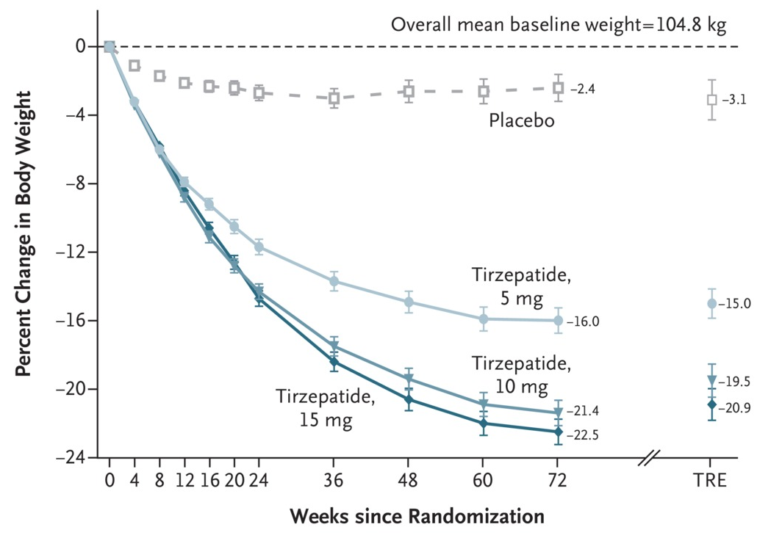
From Trials to Real Life
End Points | Tirzepatide, 5 mg (N=630) SURMOUNT-1 72w | Tirzepatide, 5 mg (N=630) REAL WORLD 17w
Percentage change in body weight | - 15.0 (-15.9 to – 14.2) | - 11.03
Weight reduction of 5% or more at week 72- percentage of partecipants | 85.1 (81.6 to 88.6) | 97.1
Weight reduction of 10% or more at week 72- percentage of partecipants | 68.5 (64.5 to 72.5) | 68.6
Weight reduction of 15% or more at week 72- percentage of partecipants | 48.0 (43.9 to 52.1) | 27.2
Change in waist circumference - cm | - 14.0 (-14.9 to -13.1) | - 13.0

Slide 16

I dati del nostro studio real-time sono in linea con I dati riportati nel trial Surmount 1;
I miglioramenti dei parametri antropometrici e cardiometabolici si verificano già dopo le prime settimane di trattamento ;
Tirzepatide si conferma un farmaco efficace e sicuro per il trattamento dell’obesità

Slide 17


